Slide 1
Southbridge Associate Meeting
May 12, 2021
“Chosen For Ministry”

Slide 2
News and Announcements

Slide 3
Reflection

Slide 4
God Knows Our Hearts
Comforting…..
Challenging……

Slide 5
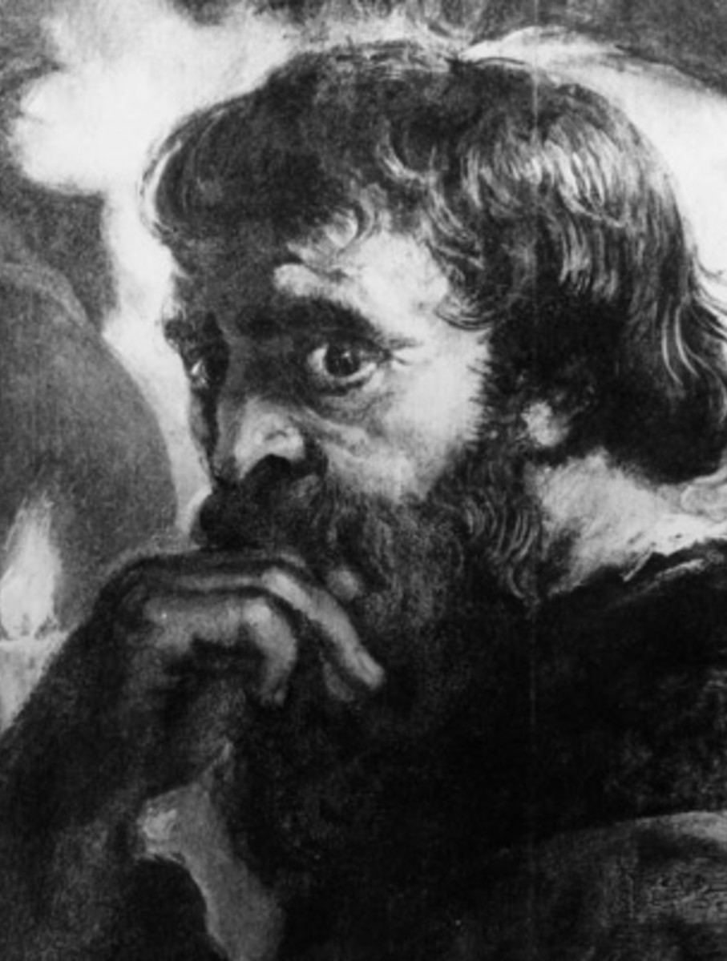
Peter’s heart…..Judas’ heart…..

Slide 6
Taize chant…
“Seigneur, tu gardes mon ame, O Dieu, tu connais mon Coeur, Conduis moi sur le chemin D’eternite”…

Slide 7
CHALLENGE
Fact is, God knows the hearts of ALL of us…can we assume people are doing the best they can?

Slide 8
This Sunday’s Gospel:
IN the world…….but not OF the world???????

Slide 9
COSMOS

Slide 10
God’s Way…..the world’s way……

Slide 11
Acts 1: 15-26 John 17: 11-19
Faith Sharing Questions:
Consider (in the words of the 1st reading) that you too, as an associate, were chosen by God, who knew your heart, and (in the words of the Gospel) gave you a mission and consecrated you for God’s sake. What does that mean to you?
With that consecration comes a requirement: we cannot join “the world’s ways…” we cannot be “defined by the world”. What does that mean to you?

Slide 12
Closing Song; “Chosen & Beloved”

