Slide 1
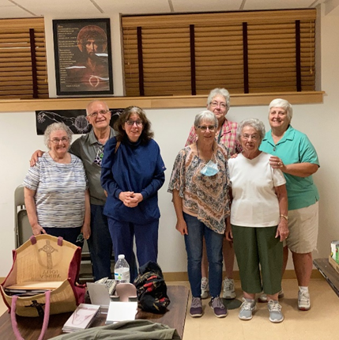
Southbridge February Meeting
Is Our Hope In God?

Slide 2
CHECKING IN………
How is everyone doing????
SASV and ASASV news… ………
March “forecast!!”

Slide 3
What is your definition of hope?

Slide 4
Our Charism: trusting in God the Provider
What does this mean day to day….like when someone I love gets sick or dies, or when hardship knocks on my door?

Slide 5
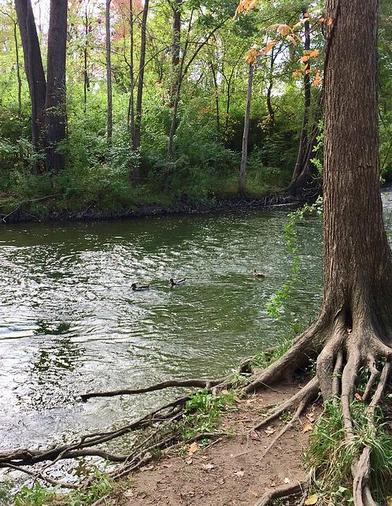
Scripture from February 13, the 6th Sunday in Ordinary Time
Jeremiah 17:5-8…
Blessed is the one who trusts in the LORD, whose hope is the LORD. He is like a tree planted beside the waters that stretches out its roots to the stream: it fears not the heat when it comes; its leaves stay green; in the year of drought it shows no distress, but still bears fruit.

Slide 6
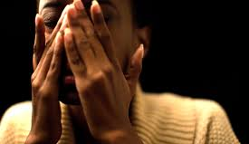
Gospel: Luke 6:17-26…
Blessed are you who are poor, for the kingdom of God is yours.
Blessed are you who are now hungry, for you will be satisfied.
Blessed are you who are now weeping, for you will laugh.

Slide 7
Coincidence????
Monday is Valentine’s day…the feast of love…no coincidence that God’s Word the day before describes what real love is all about in the Beatitudes…indeed we are the ones known by God as Blessed BECAUSE we have known love through times in our lives when we have felt very poor, hungry, deeply sad, persecuted even…times when The kingdom felt close at hand because that was when God visited us through the caring of others…and we experienced richness, fullness, laughter, comfort.

Slide 8
We don’t ever have to fear the heat, drought, hunger, sickness, loss, hardship…..

Slide 9
…..as long as our roots stretch out to the Stream…we can still bear fruit.

Slide 10
. As associates, it is the ONLY reason we can persist in trusting that God always provides.

Slide 11
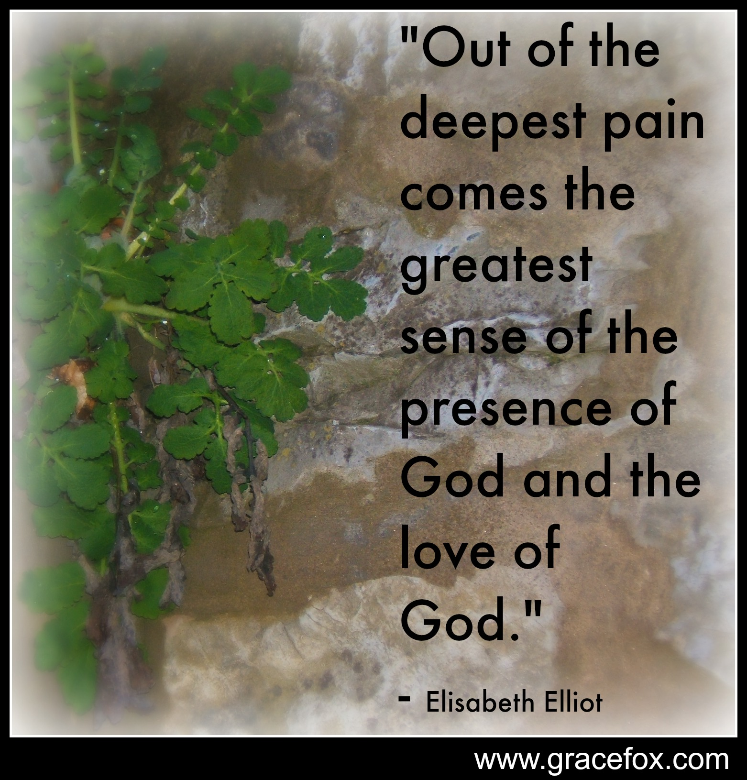
God indeed considers us blessed if we suffer need, because then we are dependent on God’s providential care and not on our own selves.

Slide 12
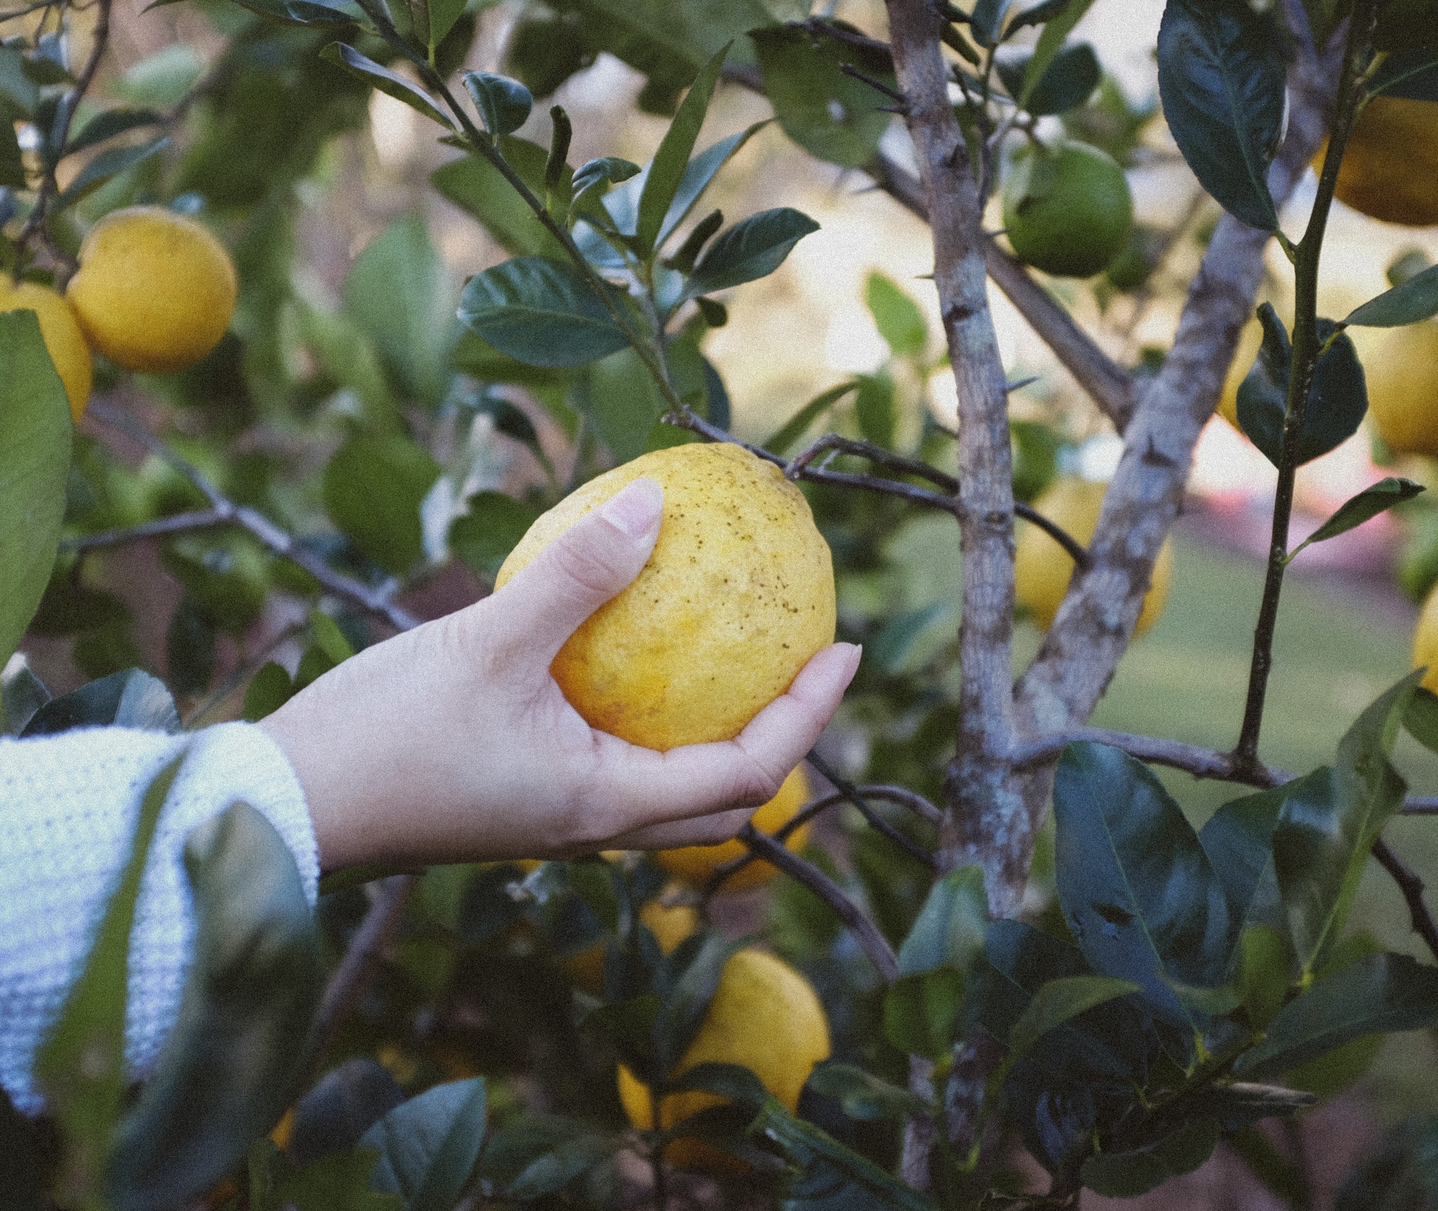
Indeed, no matter what comes our way we will be able to stay calm, show no distress, still bear fruit

Slide 13
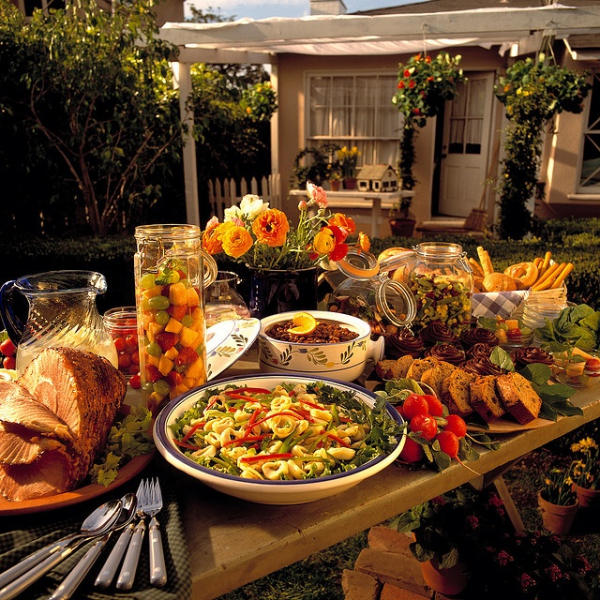
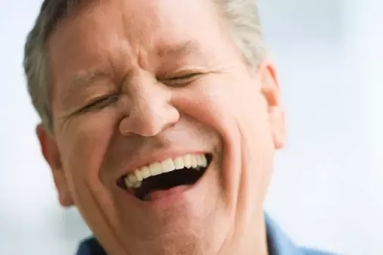
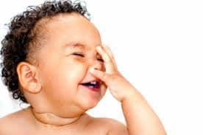
God promises that if we trust, there will always be enough…we will always be satisfied…we will have the last laugh.

Slide 14
Faith Sharing Questions (ff a few moments of silence)
What practices do you have that nourish you at God’s Stream?
How do you respond when hard times come?

Slide 15
Closing Song
“Planted By The Waters” (you tube) Myles Mitchell

